Slide 1

Green Pace
Security Policy Presentation
Developer: Zane M Deso
Notes:
Welcome to the Green Pace security policy overview. I'm Zane Deso, and this presentation covers our key standards, practices, and recommendations.

Slide 2

OVERVIEW: DEFENSE IN DEPTH
Security policy standardizes best practices for secure coding and system architecture.
Implements defense-in-depth strategies to prevent security breaches proactively.
Ensures all development team members follow consistent guidelines.
Notes:
Our policy ensures everyone develops with security in mind from the start. This proactive, layered security approach prevents vulnerabilities early.

Slide 3
THREATS MATRIX
Standard | Severity | Likelihood | Remediation Cost | Priority
STD-004-JAV | Critical | High | Medium | 5
STD-003-CPP | High | High | Medium | 5
STD-001-CPP | High | Medium | Medium | 4
STD-002-CPP | High | Medium | Medium | 4
STD-006-CPP | Medium | High | Low | 4
STD-007-CPP | High | Medium | Medium | 4
STD-005-CPP | Medium | Medium | Medium | 3
STD-008-CPP | Medium | Medium | Low | 3
STD-009-CPP | Medium | Medium | Low | 3
STD-010-CPP | Medium | Medium | Low | 3
Notes:
This matrix ranks each coding vulnerability we identified. It guides us in prioritizing remediation and allocating resources effectively.

Slide 4
10 PRINCIPLES
Validate Input Data (STD-001-CPP, STD-003-CPP, STD-006-CPP)
Heed Compiler Warnings (STD-001-CPP)
Architect and Design for Security Policies (STD-001-CPP, STD-005-CPP, STD-008-CPP, STD-009-CPP)
Keep It Simple (STD-003-CPP, STD-008-CPP, STD-009-CPP, STD-010-CPP)
Default Deny (STD-002-CPP, STD-004-JAV)
Least Privilege (STD-010-CPP)
Sanitize Data Sent to Other Systems (STD-002-CPP, STD-004-JAV)
Defense in Depth (STD-007-CPP)
Effective Quality Assurance Techniques (STD-006-CPP, STD-007-CPP)
Adopt a Secure Coding Standard (STD-001-CPP, STD-005-CPP)
Notes:
These ten principles anchor our security approach, aligning directly with specific coding standards for clarity and actionable guidance.

Slide 5
CODING STANDARDS
SQL Injection (STD-004-JAV)
Buffer Overflow Prevention (STD-003-CPP)
Enum Value Casting (STD-001-CPP)
Information Leakage Prevention (STD-002-CPP)
Complete Return Paths (STD-006-CPP)
Exception Handling (STD-007-CPP)
Object Lifecycle Management (STD-005-CPP)
Secure Object Copying (STD-008-CPP)
Stateless Predicates (STD-009-CPP)
Proper File Handling (STD-010-CPP)
Notes:
Our coding standards are ranked strategically, addressing the most severe and likely threats first to effectively reduce risks

Slide 6
ENCRYPTION POLICIES
Encryption at Rest: AES-256 for stored data.
Encryption in Flight: TLS 1.3 mandatory for all communications.
Encryption in Use: Secure memory enclaves like Intel SGX for sensitive processing.
Notes:
Encryption at all levels—rest, transit, and in use—ensures data remains protected even during breaches or attempted interceptions.

Slide 7
TRIPLE-A POLICIES
Authentication: Multi-factor authentication (MFA) required.
Authorization: Strict role-based access control (RBAC).
Accounting: Comprehensive logging for audits and real-time anomaly detection.
Notes:
Our Triple-A framework guarantees that only authorized users access resources and actions remain traceable and accountable.

Slide 8
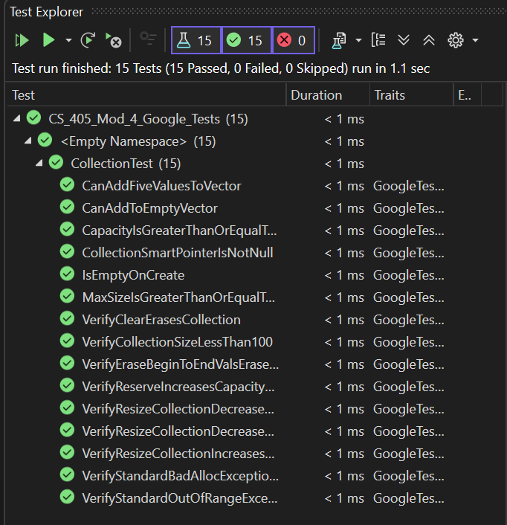
Unit Testing
Validated unit test results in Visual Studio C++ confirming defenses against buffer overflows and unsafe enum conversions..
Notes:
Unit testing frameworks integrated into Visual Studio validate code security continuously. These tests automatically highlight vulnerabilities before they reach production.

Slide 9

AUTOMATION SUMMARY

Slide 10
TOOLS
Integrate SAST tools (SonarQube, Coverity) in IDE and build pipeline.
Perform DAST testing (OWASP ZAP) pre-production.
Automated software signing and runtime protection tools deployed in production.
Notes:
Our automation strategy embeds security checks throughout the entire development lifecycle. This reduces manual errors and enhances overall resilience.

Slide 11
RISKS AND BENEFITS
Immediate action on critical/high-severity issues prevents costly breaches.
Deferring security increases risk exponentially and potential cost later.
Benefits include reduced attack surface, higher customer trust, and compliance.
Notes:
Addressing security now is cost-effective and essential. Delaying security improvements multiplies future risks and expenses.

Slide 12
RECOMMENDATIONS
Gap Analysis: Regular policy reviews and updates, continuous training.
Standards Adoption: Increase use of automated fuzz testing, continuous threat modeling practices.
Examples: Major industry breaches show critical need for timely patching and regular security policy updates (e.g., Equifax breach due to delayed patching).
Notes:
Our security posture must evolve continually. Regular policy updates, proactive training, and cutting-edge automated tests are essential moving forward.

Slide 13
CONCLUSIONS
To prevent future security problems, Green Pace should adopt stricter input validation routines across all services using centralized libraries. The team should also standardize the use of parameterized queries in all database interactions to eliminate injection vulnerabilities. Secure software development lifecycle (SSDLC) practices should be formalized, including mandated code reviews, automated static analysis, and post-deployment vulnerability scanning. Additionally, adopting industry-wide standards like NIST 800-53 and OWASP ASVS will provide a scalable and proactive security baseline for the team as it grows.
Notes:
To prevent future security issues, we need to adopt trusted standards like OWASP ASVS and NIST 800-53 across all workflows. This ensures every layer of the application meets consistent, vetted criteria for security and resilience

Slide 14
REFERENCES
National Institute of Standards and Technology. (2020). Security and Privacy Controls for Information Systems and Organizations (NIST SP 800-53 Rev. 5). https://doi.org/10.6028/NIST.SP.800-53r5
OWASP Foundation. (2021). OWASP Application Security Verification Standard 4.0.3. https://owasp.org/www-project-application-security-verification-standard/
Microsoft. (2023). Zero Trust Security Model. https://learn.microsoft.com/en-us/security/zero-trust/
Shostack, A. (2014). Threat Modeling: Designing for Security. Wiley.
Howard, M., & LeBlanc, D. (2003). Writing Secure Code (2nd ed.). Microsoft Press.
Notes:
These sources informed the structure of our policy, especially NIST’s 800-53 guidelines and OWASP’s ASVS framework. Together, they help ensure our approach is both standardized and up-to-date with the industry’s best practices.

